Slide 1



Shaping your Career Story: A complete guide to Writing Powerful Resume and Cover Letter
JAY M. TIBAYAN

Slide 2
Pre-test

Slide 3

What is resume? /ˈreɪzəˌmeɪ/
REZ-oo-may
A resume is a short, concise document that states relevant information regarding your education, skills, experiences, accomplishments, and job-related interests related to the job you are applying for .
It is a quick advertisement of who you are.

Slide 4


Slide 5
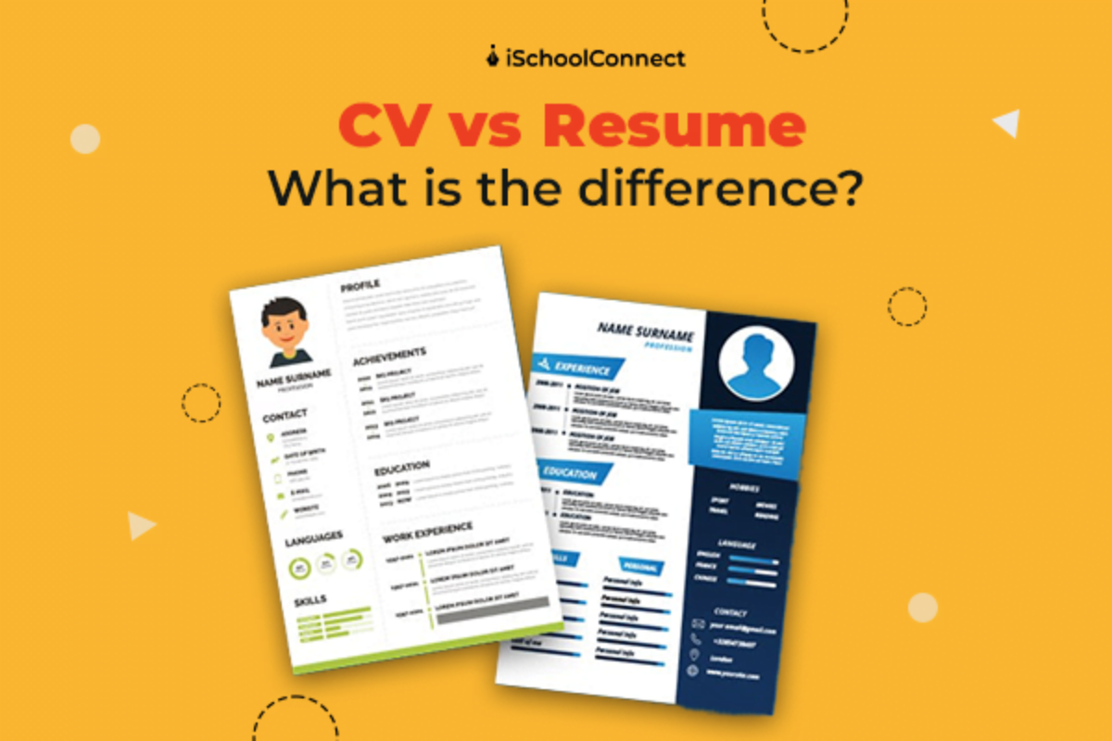
Curriculum Vitae vs. Resume

Slide 6
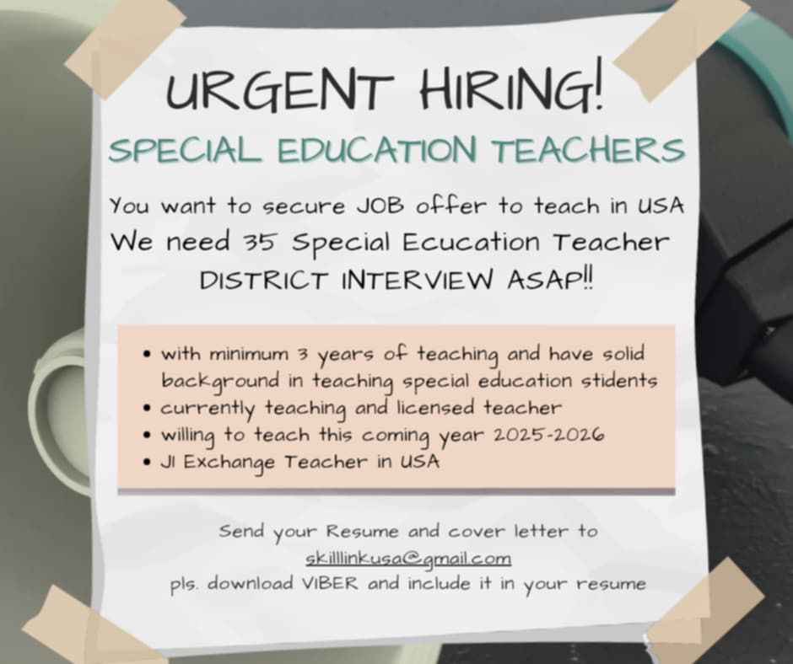

Slide 7
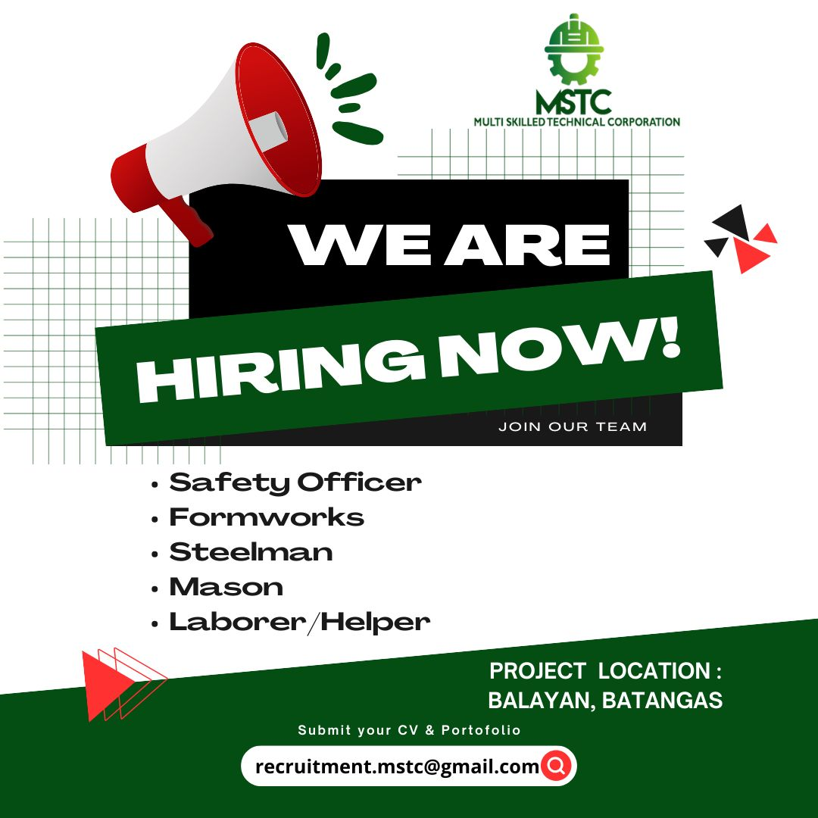

Slide 8


Characteristics of a Successful Resume
Focuses on necessary skills. Uses action words to define the responsibilities of your job-related experience.
Easy to read and understand.
Visually powerful and free from gimmicks.
One page, or at most 2 pages long.
Language is grammatically correct.
Spelling has been checked.
Formal style.
Must always be 100% truth.

Slide 9

Purpose
is to attract the attention of the employer and impress
is to provide a summary of your skills, abilities and accomplishments.
is a marketing piece that presents you in the best possible light.

Slide 10
What information should be in a Resume?
Identify yourself
Education
Continuing Education
Work or Professional Experience
Volunteer Experience
Activities Joined/Lead
Computer Skills
Professional Associations
Optional Sections
Objective, Special Skills, Reference Statement

Slide 11

Summary of Sections
Name
Address, telephone, e-mail add
Objective
Education
Experience
Achievements and Awards
Skills

Slide 12
Summary of Sections
Optional
Professional Affiliations
Publications/Project
References

Slide 13
Parts of a Resume
Identifying Information - This first section of your resume should tell who you are and help prospective employers reach you quickly.
JAY MANALO TIBAYAN
01 Brgy. Kinalaglagan, Mataasnakahoy, Batangas
09123-456-0987
jaytibayan01@gmail.com

Slide 14
Parts of a Resume
II. Job Objective-This section summarizes the type of work you want to do, and the career field in which you are interested.
1 . An exciting position within any state government agency doing interesting things.
2. To obtain a sales management position with a highly visible, multi-billion dollar, international, food distribution company located in the north eastern part of the United States, preferably New England.
3. Entry-level human services position where I can be promoted to a supervisory position.
4. To obtain an entry-level position within a financial institution requiring strong analytical and organizational skills.

Slide 15
Parts of a Resume
III.Education - For most graduates, the most important qualification they have to offer employers is their education. Therefore this section should be listed on your resume directly below your objective statement.
• List the names and dates of degrees conferred in reverse chronological order along with the names of the degree granting institutions.
•It is advisable to specify major and minor fields of study, and to list courses of particular relevance to your job objective.
•Special achievements or honors can be included in this section or in a separate section (usually titled, Honors & Awards)
•If you have a strong G.W.A., list it. At least above a 1.75

Slide 16
Education
Masters of Arts in Education major in English Teaching and Literature
2023-Present
Golden Gate Colleges
Bachelor of Secondary Education major in English
Cum Laude
GPA: 1.75
2016
Kolehiyo ng Lungsod ng Lipa

Slide 17
Work Experience
IV. Experience - For each work experience, list your position title,
the name of the organization your worked for,and the dates you worked.
Guest Lecturer
Batangas State University Pablo Borbon Main Campus
2018-2023
Teacher II
Fernando Air Base Integrated National High School
2022-present

Slide 18
Skills
Computer Skills:
Proficient in Microsoft Word, Excel, &Access, HTML, etc.
Additional Skills:
*Research skils,
Foreign Language skills, Intermediate level in Spanish

Slide 19
References
• References are individuals who can attest to your qualifications for a particular position, people who can discuss your skills and attributes.
• Create a separate page to use for listing your references. You should select 3 people to serve as your
references and list them in the order you want them to be contacted.

Slide 20
Presentation
Create an effective layout
• Try to interest your reader visually
• A clean, professional format with a little style
• Extra white space makes it easy to read - set margins
For text: a serif font like Times
For headings: Arial or Helvetica are good choices to add visual interest
Don't choose non-standard fonts like Comic Sans or Lucida Handwriting
Font size should be 11 or 12 point

Slide 21

Final Thoughts
• Choose the correct tense and use it consistently
• D o not ask for a particular salary
• B e accurate and honest
• P r i n t it out! Do not attempt to proofread on screen

Slide 22
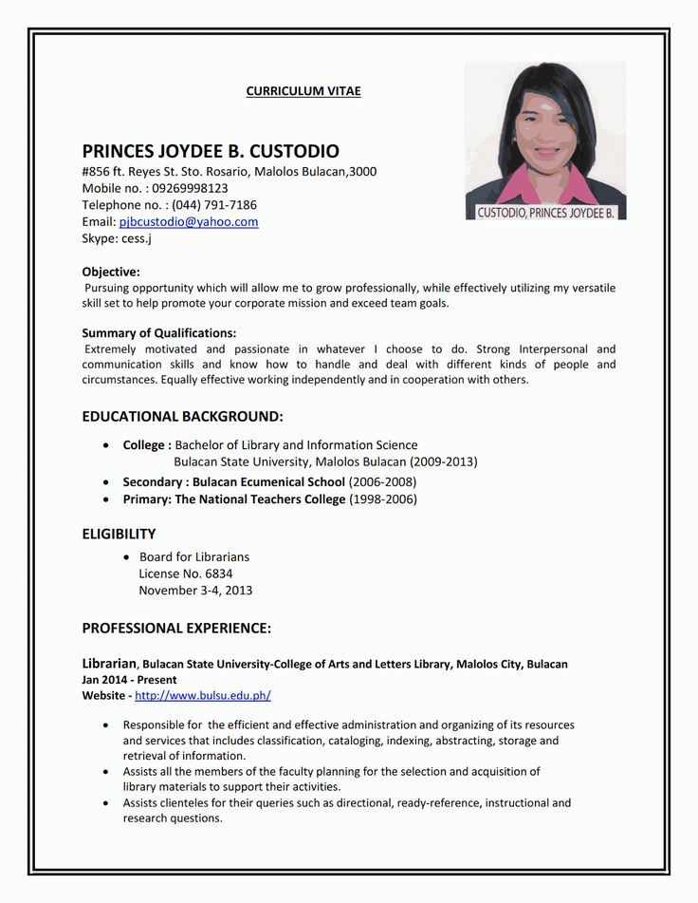
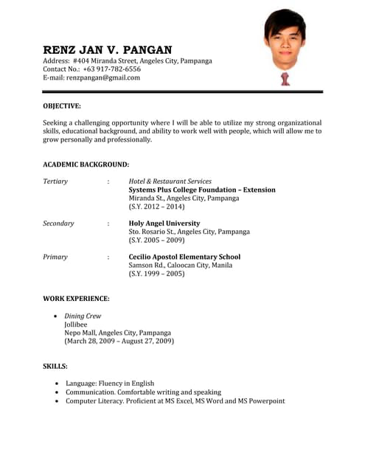

Slide 23
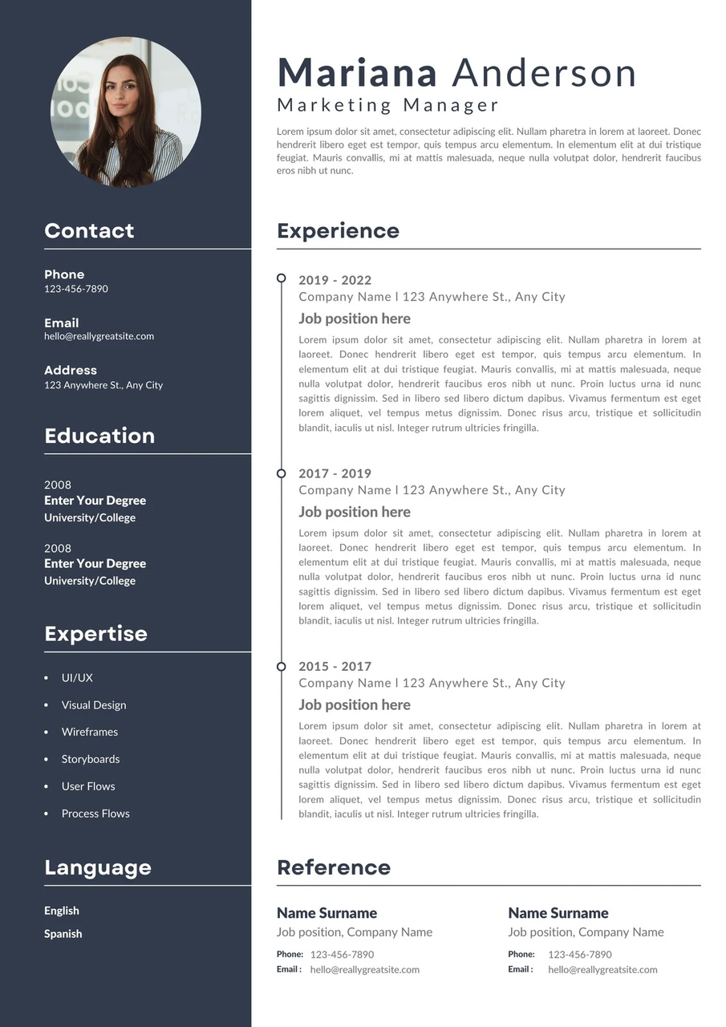
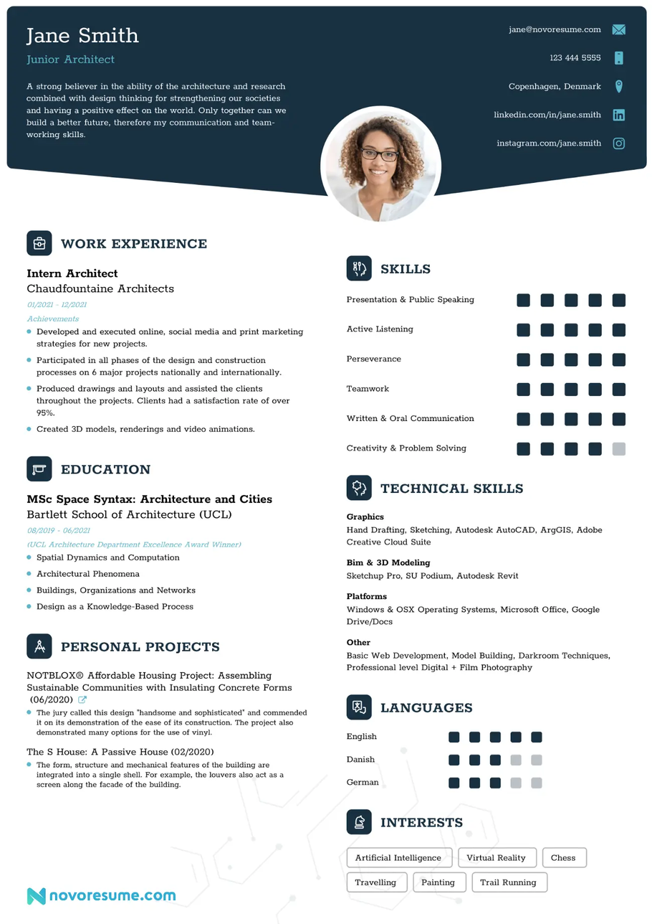

Slide 24
Cover Letter or Application Letter Writing

Slide 25
What is a cover letter?
A cover letter is a letter sent alongside your resume to introduce yourself, explain why you are sending in your resume, and provide more information about yourself.

Slide 26
Purpose
The purpose of acover letter is to tell a prospective employer what you can do and why you feel you are qualified.
• It is an opportunity to demonstrate your writing skills and it opens a window to vour personality.
• A good-well planned cover letter is just as important as an impressive resume, and together they form an important resource in your job campaign.

Slide 27
What information should be in a Cover Letter?
• 3-4 paragraphs in length (MAX) stating your interest in the position and just a bit of an overview of why you are qualified for the position.
• Average view is 4.2 seconds for a committee to look at a cover letter - be brief (but efficient)

Slide 28
What information should be in a Cover Letter?
A cover letter should be formatted like a business letter with these sections:
Header with date and contact information
Salutation or greeting
Opening paragraph
Middle paragraph(s)
Closing paragraph
Letter ending and signature

Slide 29
What information should be in a Cover Letter?
Your cover letter should be one page long and use a simple, professional font, such as Arial or Helvetica, 10 to 12 points in size. Your letter should be left-aligned with single spacing and one-inch margins.

Slide 30
How to Write?
6 easy steps for Cover Letter Writing
1
Start with your header
Header template:
Your name
Your city and ZIP code
Your phone number
Your email address
Date
Name of recipient
Title/Position of recipient
Company name
Company address
Jay M. Tibayan
Mataasnakahoy, Batangas, 4223
0912-345-6789
jaytibayan01@gmail.com
May 29, 2024
Dr. Tirso A. Ronquillo
President
Batangas State University
Batangas City

Slide 31
How to Write?
6 easy steps for Cover Letter Writing
2
2. Include a greeting/ Salutation
In your research, try to find the name of the person reviewing applications for the job. Address your letter to this person with a common business greeting, such as "Dear [first and last name]" or "Dear [position title]." Avoid using "To whom it may concern."
Greetings example:
Dear Dr. Tirso,
Dear Ms. Anabel Castro,
Dear Hiring Manager,

Slide 32
How to Write?
6 easy steps for Cover Letter Writing
3
Write an opening paragraph
In the first paragraph, mention the job title you're applying for and where you saw the position posting. Explain your interest in the role and company to show you've done your research. The first section of your cover letter is also the first impression the reader will have of you, so it's important to appeal to that person quickly.
I'm excited to apply for the Graphic Designer position at Cloud Clearwater as it was advertised in Facebook. I understand you're currently adding several new product lines, and I believe my skills in video and animation provide a significant advantage for creating a successful launch. As a longtime fan of your products, I'm thrilled at the opportunity to bring my unique style and passion for beachwear to the company."

Slide 33
How to Write?
6 easy steps for Cover Letter Writing
4
As the Head of Human Resources at Wes Morgan Philips, I was a key senior leader in the organization and was responsible for improving the efficiency and performance of the company's 540 employees. Before that, I worked in human resources, equal employment opportunity and diversity for Jenkins Technology Solutions, Inc. At Jenkins Technology, I developed an employee retention plan involving a wellness program, an internal training program and a promotions selection process. This led to a 50% reduction in the overall employee turnover rate."
4. Add a second paragraph
Your second paragraph should be a brief overview of your background as it relates to the position. Include key achievements, skills and specialties that make you particularly suited to the position. Focus on one or two and provide specific details about your success, including measurable impacts you made.

Slide 34
How to Write?
6 easy steps for Cover Letter Writing
5
"Achieving ambitious marketing goals is always a top priority, and I am always looking out for the company's best interests. I enjoy delivering marketing presentations to potential clients and focusing on an organization's strengths. My marketing skills at River Tech helped the company experience new levels of success and a 45% increase in customer engagement. I'm never satisfied with the status quo, and I believe that a company should continually look for ways to improve and reach new clients through innovative campaigns."
Finish with a closing paragraph
The closing paragraph should focus on another key achievement or skill relevant to the position. Instead of repeating details from your resume, summarize a specific story or anecdote that displays you're right for the role. If you're changing careers, this is a good opportunity to talk about transferable skills or relatable experiences from your career.

Slide 35
How to Write?
6 easy steps for Cover Letter Writing
6
"Thank you for your time and consideration. I look forward to learning more about the sales position and TradeLot. Growth is essential to my continued success, and I'm excited for the chance to be a part of TradeLot's industry-leading team. My proven track record and TradeLot's quality products are a winning combination for increasing the company's market share.
Sincerely,
Jay Tibayan
6. End with a professional signoff
You should end your cover letter with a paragraph summarizing why you are applying for the role and why you would be a great fit. Keep the cover letter conclusion brief and explain that you look forward to the employer's response about possible next steps. End with your signature at the bottom.

Slide 36
Post-test

Slide 37
Your resume should include every job you’ve ever had.
False – Only include relevant experience tailored to the job you're applying for.

Slide 38
A cover letter should be customized for each job application.
True – Personalizing your cover letter shows genuine interest and increases your chances.

Slide 39
It’s okay to use the same generic objective statement on every resume.
False – Objective or summary statements should be specific and aligned with the job.

Slide 40
You should always include measurable achievements in your resume.
True – Quantifying your accomplishments makes your impact clearer and more impressive.

Slide 41
Your cover letter should repeat everything in your resume.
False – A cover letter should complement, not duplicate, your resume by adding context and personality.

Slide 42




Slide 43
It is important to proofread your cover letter and resume for any spelling or grammatical errors before submitting them.

Slide 44
Including hobbies and personal interests on your resume can help you stand out to potential employers.

Slide 45
Your resume should be limited to one page in length or in a max of two.

Slide 46
Your cover letter should be longer than your resume to provide more detailed information.

Slide 47
Your cover letter should highlight your relevant skills and experiences that align with the job requirements.

Slide 48
Every great career starts with a single, well-written page. Keep refining, keep growing, and trust the process. You've got this!

Slide 49

Every great career starts with a single, well-written page. Keep refining, keep growing, and trust the process. You've got this!

